Slide 1

Forecasting
Chapter # 3

Slide 2
INTRODUCTION
➢ Forecasts are a basic input in the decision processes of operations management because they provide information on future demand.
➢ The importance of forecasting to operations management cannot be overstated.
➢ The primary goal of operations management is to match supply to demand.
➢ Having a forecast of demand is essential for determining how much capacity or supply will be needed to meet demand.
➢ For instance, operations needs to know what capacity will be needed to make staffing and equipment decisions, budgets must be prepared, purchasing needs information for ordering from suppliers, and supply chain partners need to make their plans.

Slide 3
INTRODUCTION
➢ Businesses make plans for future operations based on anticipated future demand.
➢ Anticipated demand is derived from two possible sources, actual customer orders and forecasts.
➢ For businesses where customer orders make up most or all of anticipated demand, planning is straightforward, and little or no forecasting is needed.
➢ However, for many businesses, most or all of anticipated demand is derived from forecasts.

Slide 4
INTRODUCTION
➢ Forecasts are made with reference to a specific time horizon.
➢ The time horizon may be fairly short (e.g., an hour, day, week, or month), or somewhat longer (e.g., the next six months, the next year, the next five years, or the life of a product or service).
➢ Short-term forecasts refers to ongoing operations.
➢ Long-range forecasts can be an important strategic planning tool.
➢ Long- term forecasts pertain to new products or services, new equipment, new facilities, or something else that will require a somewhat long lead time to develop, construct, or otherwise implement.

Slide 5
INTRODUCTION
➢ Forecasts are the basis for budgeting, planning capacity, sales, production and inventory, personnel, purchasing, and more.
➢ Forecasts play an important role in the planning process because they enable managers to anticipate the future so they can plan accordingly.
➢ Forecasts affect decisions and activities throughout an organization, in accounting, finance, human resources, marketing, and management information systems (MIS), as well as in operations and other parts of an organization.

Slide 6
INTRODUCTION
➢ Accounting
New product/process cost estimates, profit projections, cash management.
➢ Finance
Equipment/equipment replacement needs, timing and amount of funding/ borrowing needs.
➢ Human Resources
Hiring activities, including recruitment, interviewing, and training; layoff planning, including outplacement counseling.

Slide 7
INTRODUCTION
➢ Marketing
Pricing and promotion, e-business strategies, global competition strategies.
➢ MIS
New/revised information systems, internet services.
➢ Operations
Schedules, capacity planning, work assignments and workloads, inventory planning, make-or-buy decisions, outsourcing, project management.
➢ Product/service design
Revision of current features, design of new products or services.

Slide 8
INTRODUCTION
➢ Forecasting is also an important component of yield management, which relates to the percentage of capacity being used.
➢ Accurate forecasts can help managers plan tactics (e.g., offer discounts, don’t offer discounts) to match capacity with demand, thereby achieving high-yield levels.

Slide 9
INTRODUCTION
➢ There are two uses for forecasts.
➢ One is to help managers plan the system, and the other is to help them plan the use of the system.
➢ Planning the system generally involves long-range plans about the types of products and services to offer, what facilities and equipment to have, where to locate, and so on.
➢ Planning the use of the system refers to short-range and intermediate-range planning, which involve tasks such as planning inventory and workforce levels, planning purchasing and production, budgeting, and scheduling.

Slide 10
FEATURES COMMON TO ALL FORECASTS
➢ A wide variety of forecasting techniques are in use.
➢ In many respects, they are quite different from each other, as you shall soon discover.
➢ Nonetheless, certain features are common to all, and it is important to recognize them.
➢ Forecasting techniques generally assume that the same underlying causal system that existed in the past will continue to exist in the future.

Slide 11
FEATURES COMMON TO ALL FORECASTS
➢ Forecasts are not perfect; actual results usually differ from predicted values; the presence of randomness precludes a perfect forecast. Allowances should be made for forecast errors.
➢ Forecasts for groups of items tend to be more accurate than forecasts for individual items because forecasting errors among items in a group usually have a canceling effect. Opportunities for grouping may arise if parts or raw materials are used for multiple products or if a product or service is demanded by a number of independent sources.
➢ Forecast accuracy decreases as the time period covered by the forecast—the time horizon—increases. Generally speaking, short-range forecasts must contend with fewer uncertainties than longer-range forecasts, so they tend to be more accurate.

Slide 12
ELEMENTS OF A GOOD FORECAST
A properly prepared forecast should fulfill certain requirements:
➢ The forecast should be timely. Usually, a certain amount of time is needed to respond to the information contained in a forecast. For example, capacity cannot be expanded overnight, nor can inventory levels be changed immediately. Hence, the forecasting horizon must cover the time necessary to implement possible changes.
➢ The forecast should be accurate, and the degree of accuracy should be stated. This will enable users to plan for possible errors and will provide a basis for comparing alternative forecasts.

Slide 13
ELEMENTS OF A GOOD FORECAST
➢ The forecast should be reliable; it should work consistently. A technique that sometimes provides a good forecast and sometimes a poor one will leave users with the uneasy feeling that they may get burned every time a new forecast is issued.
➢ The forecast should be expressed in meaningful units. Financial planners need to know how many dollars will be needed, production planners need to know how many units will be needed, and schedulers need to know what machines and skills will be required. The choice of units depends on user needs.
➢ The forecast should be in writing. Although this will not guarantee that all concerned are using the same information, it will at least increase the likelihood of it. In addition, a written forecast will permit an objective basis for evaluating the forecast once actual results are in.

Slide 14
ELEMENTS OF A GOOD FORECAST
➢ The forecasting technique should be simple to understand and use. Users often lack confidence in forecasts based on sophisticated techniques; they do not understand either the circumstances in which the techniques are appropriate or the limitations of the techniques. Misuse of techniques is an obvious consequence. Not surprisingly, fairly simple forecasting techniques enjoy widespread popularity because users are more comfortable working with them.
➢ The forecast should be cost-effective: The benefits should outweigh the costs.

Slide 15
APPROACHES TO FORECASTING
➢ There are two general approaches to forecasting: qualitative and quantitative.
➢ Qualitative methods consist mainly of subjective inputs, which often confront precise numerical description.
➢ Quantitative methods involve either the projection of historical data or the development of associative models that attempt to utilize causal (explanatory) variables to make a forecast.
➢ Qualitative techniques permit inclusion of soft information (e.g., human factors, personal opinions) in the forecasting process.
➢ Those factors are often omitted or downplayed when quantitative techniques are used because they are difficult or impossible to quantify.
➢ Quantitative techniques consist mainly of analyzing objective, or hard, data.

Slide 16
APPROACHES TO FORECASTING
The following pages present a variety of forecasting techniques that are classified as judgmental, time-series, or associative.
➢ Judgmental forecasts rely on analysis of subjective inputs obtained from various sources, such as consumer surveys, the sales staff, managers and executives, and panels of experts.
Quite frequently, these sources provide insights that are not otherwise available.

Slide 17
APPROACHES TO FORECASTING
➢ Time-series forecasts simply attempt to project past experience into the future.
These techniques use historical data with the assumption that the future will be like the past.
Some models merely attempt to smooth out random variations in historical data; others attempt to identify specific patterns in the data and project or extrapolate those patterns into the future, without trying to identify causes of the patterns.

Slide 18
APPROACHES TO FORECASTING
➢ Associative models use equations that consist of one or more explanatory variables that can be used to predict demand.
For example, demand for paint might be related to variables such as the price per gallon and the amount spent on advertising, as well as to specific characteristics of the paint (e.g., drying time, ease of cleanup).

Slide 19
FORECASTS BASED ON TIME-SERIES DATA
➢ A time series is a time-ordered sequence of observations taken at regular intervals (e.g., hourly, daily, weekly, monthly, quarterly, annually).
➢ The data may be measurements of demand, sales, earnings, profits, shipments, accidents, output, precipitation, productivity, or the consumer price index.
➢ Forecasting techniques based on time-series data are made on the assumption that future values of the series can be estimated from past values.
➢ Analysis of time-series data requires the analyst to identify the underlying behavior of the series.
➢ This can often be accomplished by merely plotting the data and visually examining the plot.
➢ One or more patterns might appear: trends, seasonal variations, cycles, or variations around an average.

Slide 20
FORECASTS BASED ON TIME-SERIES DATA
1. Trend refers to a long-term upward or downward movement in the data.
Population shifts, changing incomes, and cultural changes often account for such movements.
2. Seasonality refers to short-term, fairly regular variations generally related to factors such as the calendar or time of day.
Restaurants, supermarkets, and theaters experience weekly and even daily “seasonal” variations.
3. Cycles are wavelike variations of more than one year’s duration.
These are often related to a variety of economic, political, and even agricultural conditions.

Slide 21
FORECASTS BASED ON TIME-SERIES DATA
4. Irregular variations are due to unusual circumstances such as severe weather conditions, strikes, or a major change in a product or service.
They do not reflect typical behavior, and their inclusion in the series can distort the overall picture.
Whenever possible, these should be identified and removed from the data.
5. Random variations are residual variations that remain after all other behaviors have been accounted for.

Slide 22
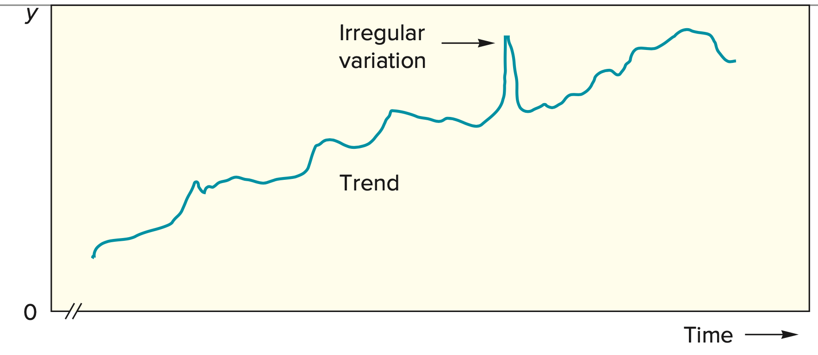
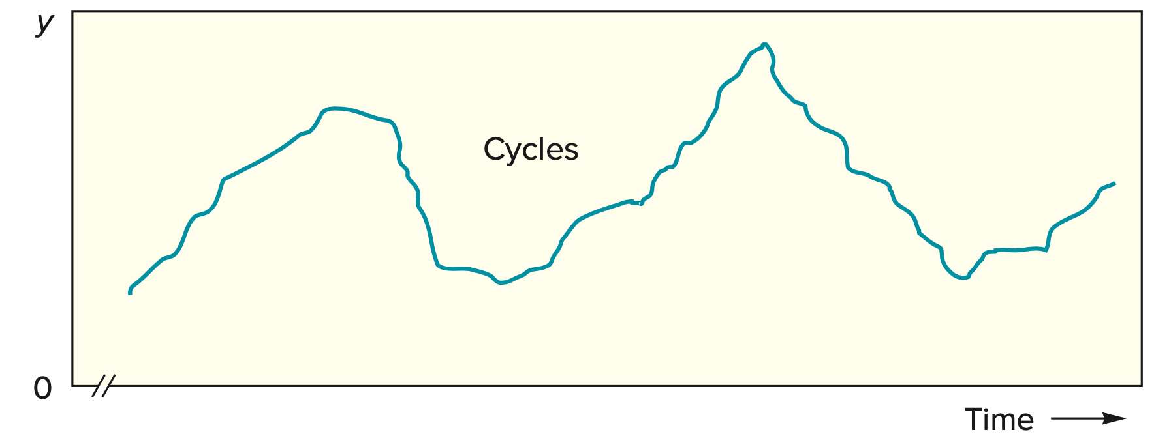
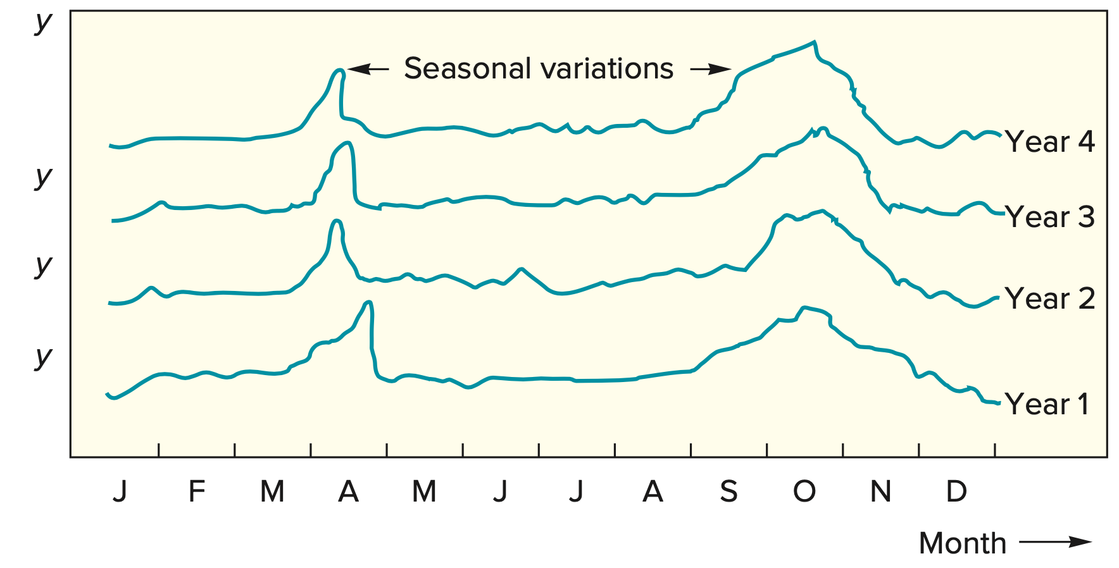
FORECASTS BASED ON TIME-SERIES DATA

Slide 23
FORECASTS BASED ON TIME-SERIES DATA
➢ Naive Methods
A simple but widely used approach to forecasting is the naive approach.
A naive forecast uses a single previous value of a time series as the basis of a forecast.
The naive approach can be used with a stable series (variations around an average), with seasonal variations, or with trend.
With a stable series, the last data point becomes the forecast for the next period.
Thus, if demand for a product last week was 20 cases, the forecast for this week is 20 cases.

Slide 24
FORECASTS BASED ON TIME-SERIES DATA
Naive Methods
For example, suppose the last two values were 50 and 53.
The next forecast would be 56:
Change from:
Period Actual Previous Value Forecast
1 50 ---
2 53 +3
3 53+3=56

Slide 25
FORECASTS BASED ON TIME-SERIES DATA
Naive Methods
Change from:
Period Sales
1 50
2 53
3 55
4 58
5 ???
Forecast for F5 = 58, as the interval is not consistent, therefore have to take the most recent value.

Slide 26
TECHNIQUES FOR AVERAGING
➢ Averaging techniques generate forecasts that reflect recent values of a time series (e.g., the average value over the last several periods).
➢ These techniques work best when a series tends to vary around an average, although they also can handle step changes or gradual changes in the level of the series.
➢ Three techniques for averaging are described in this section:
1. Moving average
2. Weighted moving average
3. Exponential smoothing

Slide 27
TECHNIQUES FOR AVERAGING
➢ Moving Average
One weakness of the naive method is that the forecast just traces the actual data, with a lag of one period; it does not smooth at all.
But by expanding the amount of historical data a forecast is based on, this difficulty can be overcome.
A moving average forecast uses a number of the most recent actual data values in generating a forecast.

Slide 28
TECHNIQUES FOR AVERAGING
The moving average forecast can be computed using the following equation:
n
∑
A_{t-i}
F_{t}
=
MA_{n}
=
i = 1
n
F_{t} = Forecast for time period t
MA_{n} = n period moving average
A_{t-1} = Actual value in period t-1
More recent values in a series are given more weight in computing the forecast.
For example, MA3 would refer to a three-period moving average forecast, and MA5 would refer to a five-period moving average forecast.

Slide 29
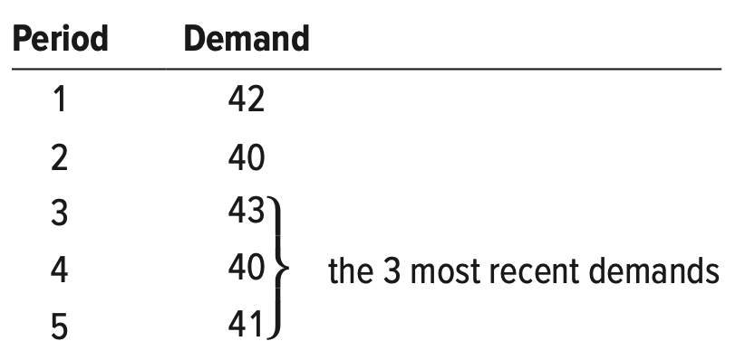
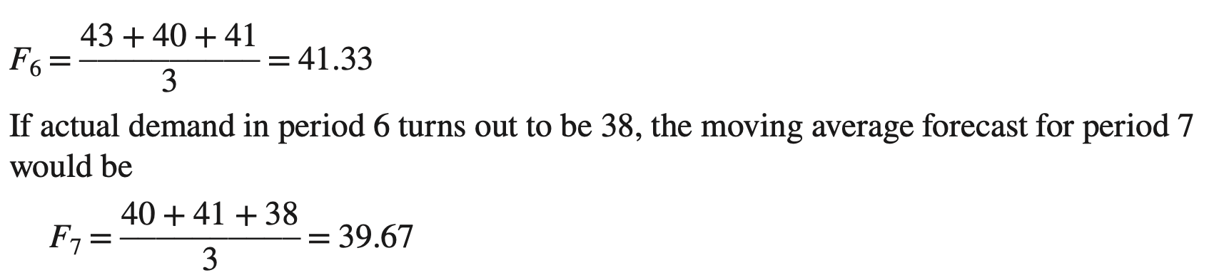
TECHNIQUES FOR AVERAGING
Computing a Moving Average
Compute a three-period moving average forecast given demand for shopping carts for the last five periods.

Slide 30
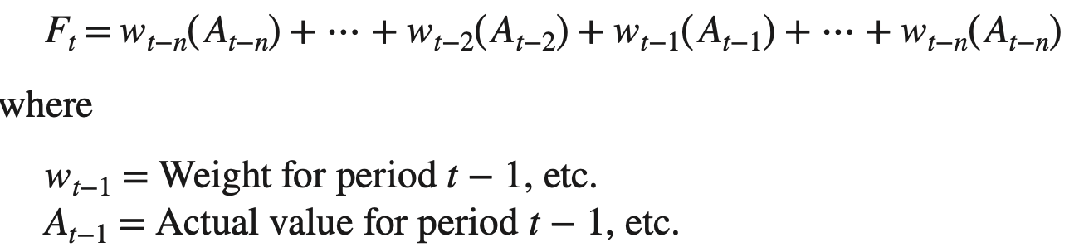
TECHNIQUES FOR AVERAGING
➢ Weighted Moving Average
A weighted average is similar to a moving average, except that it typically assigns more weight to the most recent values in a time series.
For instance, the most recent value might be assigned a weight of .40, the next most recent value a weight of .30, the next after that a weight of .20, and the next after that a weight of .10.
Note that the weights must sum to 1.00, and that the heaviest weights are assigned to the most recent values.

Slide 31
TECHNIQUES FOR AVERAGING
➢ Weighted Moving Average
Computing a Weighted Moving Average
Given the following demand data:
Period Demand
1 42
2 40
3 43
4 40
5 41
a. Compute a weighted average forecast using a weight of .40 for the most recent period, .30 for the next most recent, .20 for the next, and .10 for the next.
b. If the actual demand for period 6 is 39, forecast demand for period 7 using the same weights as in part a.

Slide 32
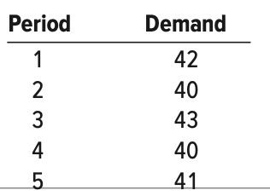
TECHNIQUES FOR AVERAGING
➢ Weighted Moving Average
Computing a Weighted Moving Average
a. Compute a weighted average forecast using a weight of .40 for the most recent period, .30 for the next most recent, .20 for the next, and .10 for the next.
F6 = .10(40) + .20(43) + .30(40) + .40(41) = 41.0
b. If the actual demand for period 6 is 39, forecast demand for period 7 using the same weights as in part a.
F7 = .10(43) + .20(40) + .30(41) + .40(39) = 40.2

Slide 33
TECHNIQUES FOR AVERAGING
➢ Exponential Smoothing
Exponential smoothing is a sophisticated weighted averaging method that is still relatively easy to use and understand.
Each new forecast is based on the previous forecast plus a percentage of the difference between that forecast and the actual value of the series at that point

Slide 34
TECHNIQUES FOR AVERAGING
➢ Exponential Smoothing
Next forecast = Previous forecast + α(Actual − Previous forecast)
where (Actual − Previous forecast) represents the forecast error and α is a percentage of the error.
More concisely,
F_{t} = F_{t−1} + α( A_{t−1} − F_{t−1})
Where,
F_{t} = Forecast for period t
F_{t−1} = Forecast for the previous period (i.e., period t − 1)
α = Smoothing constant (percentage, usually less than 50%)
A_{t−1} = Actual demand or sales for the previous period

Slide 35
TECHNIQUES FOR AVERAGING
➢ Exponential Smoothing
The smoothing constant α represents a percentage of the forecast error.
Each new forecast is equal to the previous forecast plus a percentage of the previous error.
α = 15% = 0.15
Period Data
1 10
2 14
3 12
4 19
5 8
Calculate the Forecasted Value of Period 6?
Therefore, F₍₆₎ ₌ F₍₅₎ + α (A₅ - F₅)

Slide 36
TECHNIQUES FOR AVERAGING
➢ Exponential Smoothing
Period Data
1 10
2 14
3 12
4 19
5 8
F₍₁₎ ₌ Not Applicable
F₍₂₎ ₌ A₁ = 10
F₍₃₎ ₌ F₍₂₎ + α (A₂ – F₂) = 10 + 0.15 (14-10) = 10.60
F₍₄₎ ₌ F₍₃₎ + α (A₃ – F₃) = 10.60 + 0.15 (12-10.60) = 10.81
F₍₅₎ ₌ F₍₄₎ + α (A₄ – F₄) = 10.81 + 0.15 (19-10.81) = 12.03
F₍₆₎ ₌ F₍₅₎ + α (A₅ – F₅) = 12.03 + 0.15 (8-12.03) = 11.43

Slide 37
TECHNIQUES FOR AVERAGING
➢ Exponential Smoothing
For example, suppose the previous forecast was 42 units, actual demand was 40 units, and α = .10.
The new forecast would be computed as follows:
F_{t} = 42 + .10(40 − 42 ) = 41.8
Then, if the actual demand turns out to be 43, the next forecast would be
F_{t} = 41.8 + .10(43 − 41.8)= 41.92

Slide 38
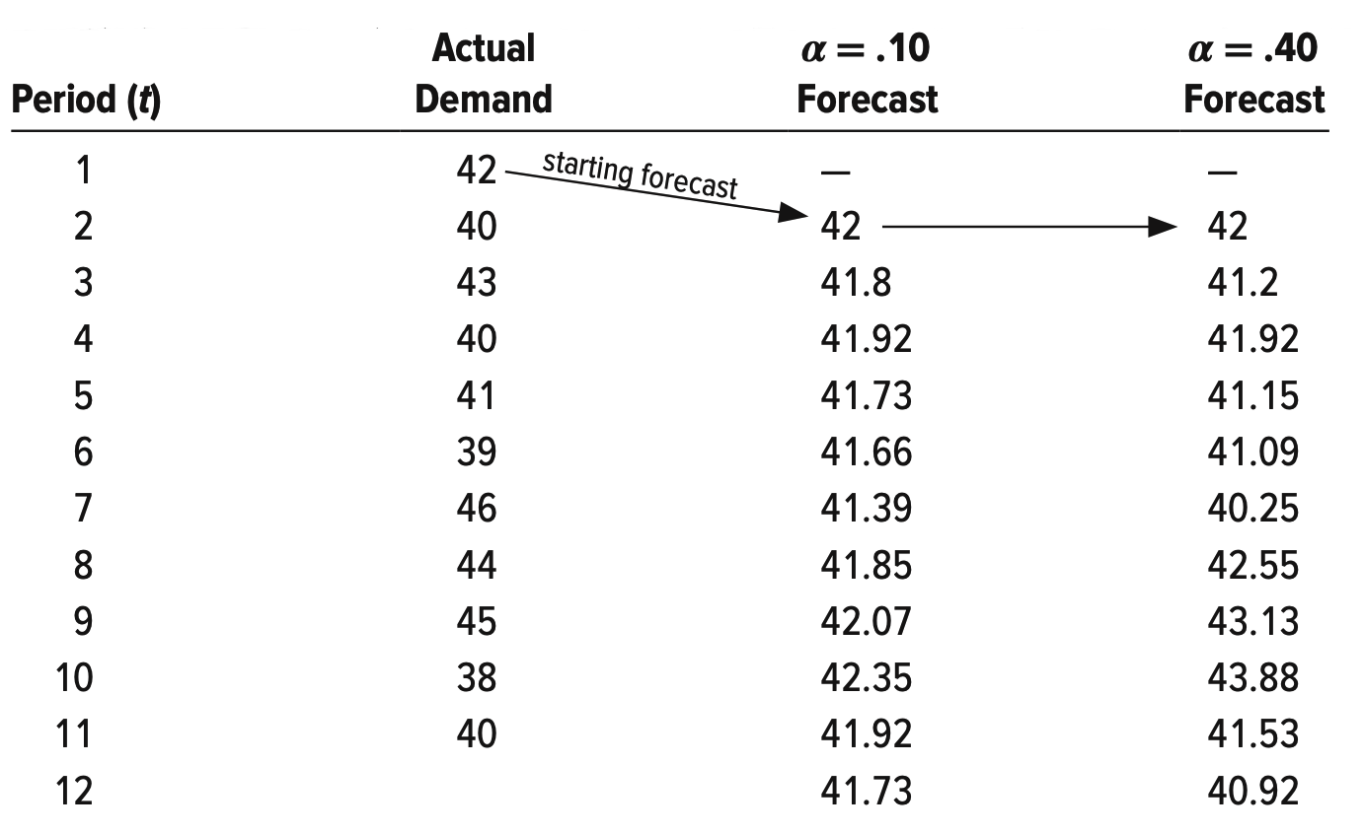
TECHNIQUES FOR AVERAGING
➢ Exponential Smoothing
F2
F12=???
F12= F11+ α (A11-F11)
= 41.92+ 0.1(40-41.92)
= 41.73
F3= F2+ α(A2-F2)
= 42+ 0.1 (40-42)
= 41.8

Slide 39
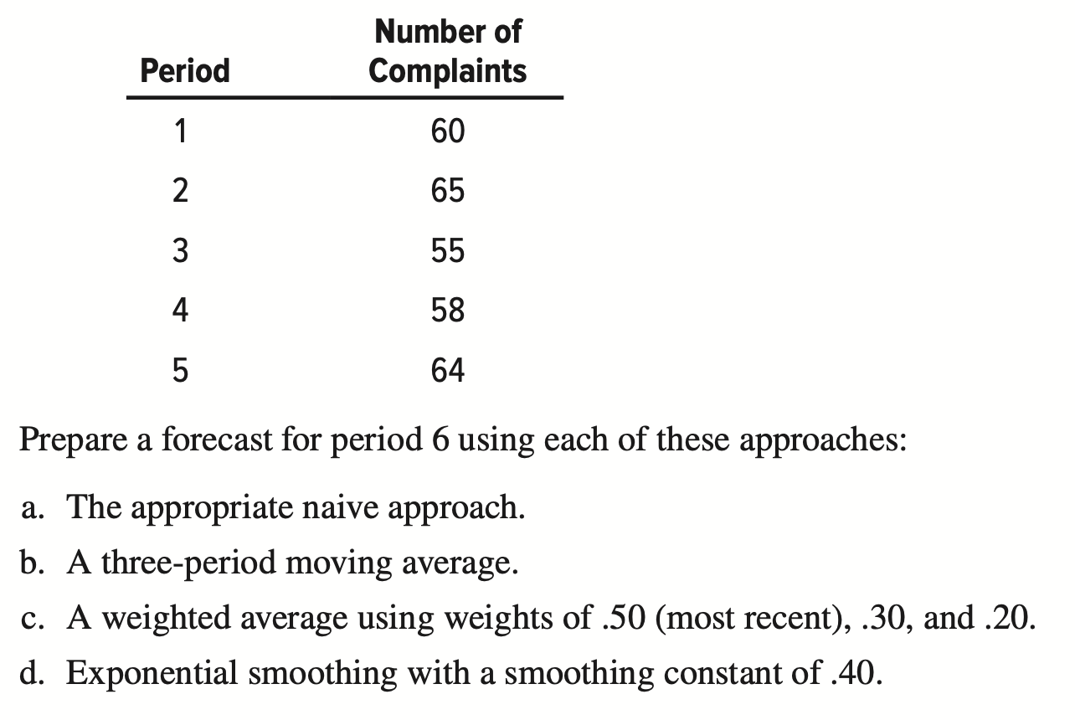
TECHNIQUES FOR AVERAGING

Slide 40
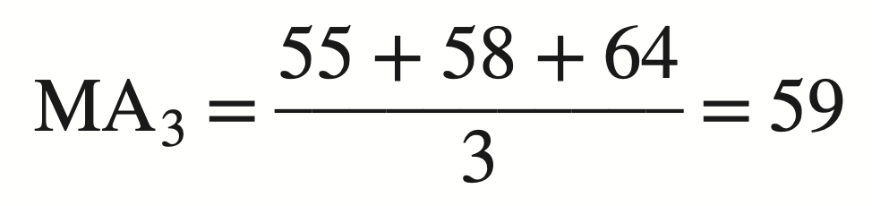
TECHNIQUES FOR AVERAGING
a.
b.

Slide 41
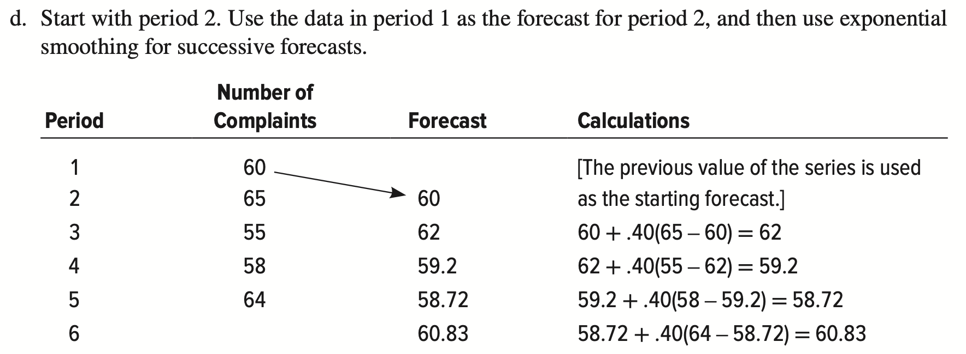
TECHNIQUES FOR AVERAGING

Slide 42
SUMMARIZING FORECAST ACCURACY
➢ Forecast accuracy is a significant factor when deciding among forecasting alternatives.
➢ Accuracy is based on the historical error performance of a forecast.
➢ Three commonly used measures for summarizing historical errors are the mean absolute deviation (MAD), the mean squared error (MSE), and the mean absolute percent error (MAPE).
➢ MAD is the average absolute error, MSE is the average of squared errors, and MAPE is the average absolute percent error.

Slide 43
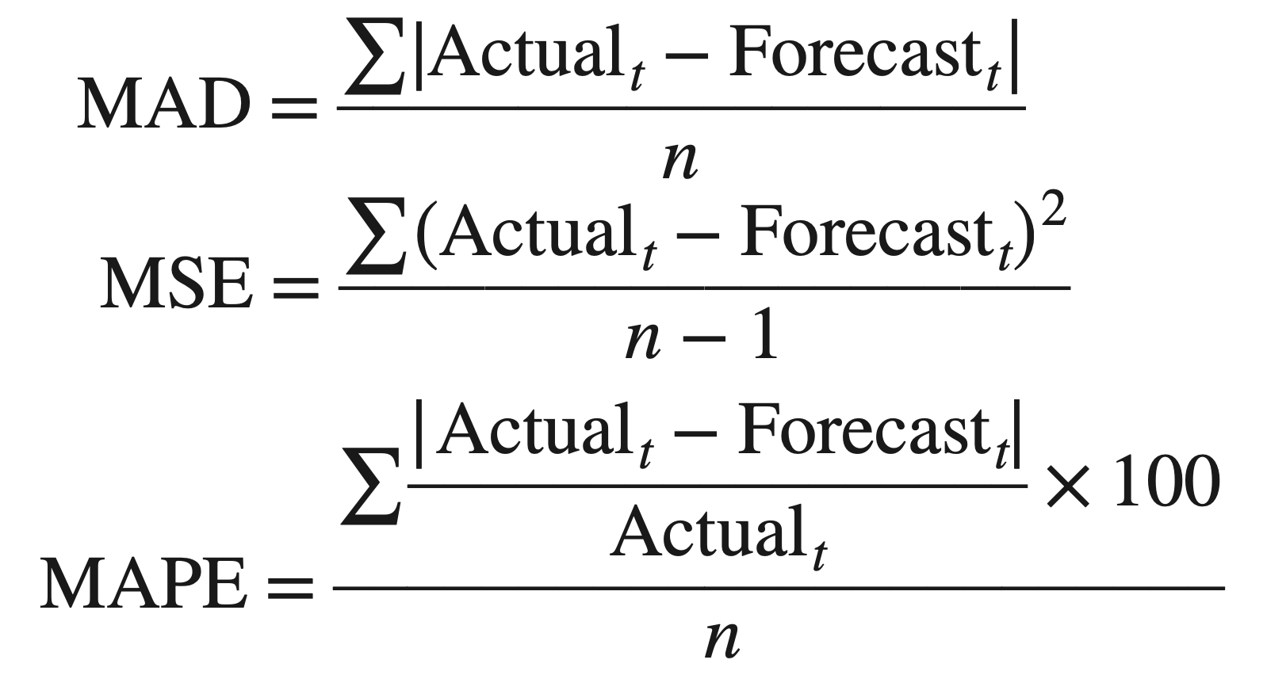
SUMMARIZING FORECAST ACCURACY
The formulas used to compute MAD, MSE, and MAPE are as follows:

Slide 44
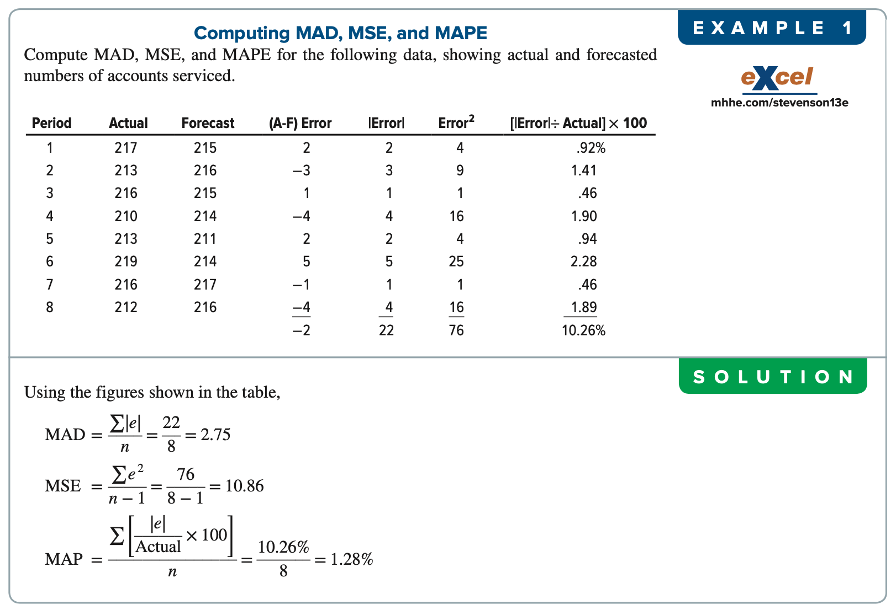
SUMMARIZING FORECAST ACCURACY
+8, +2, +1, -1, -3, -7 = 0
E= 0,

Slide 45
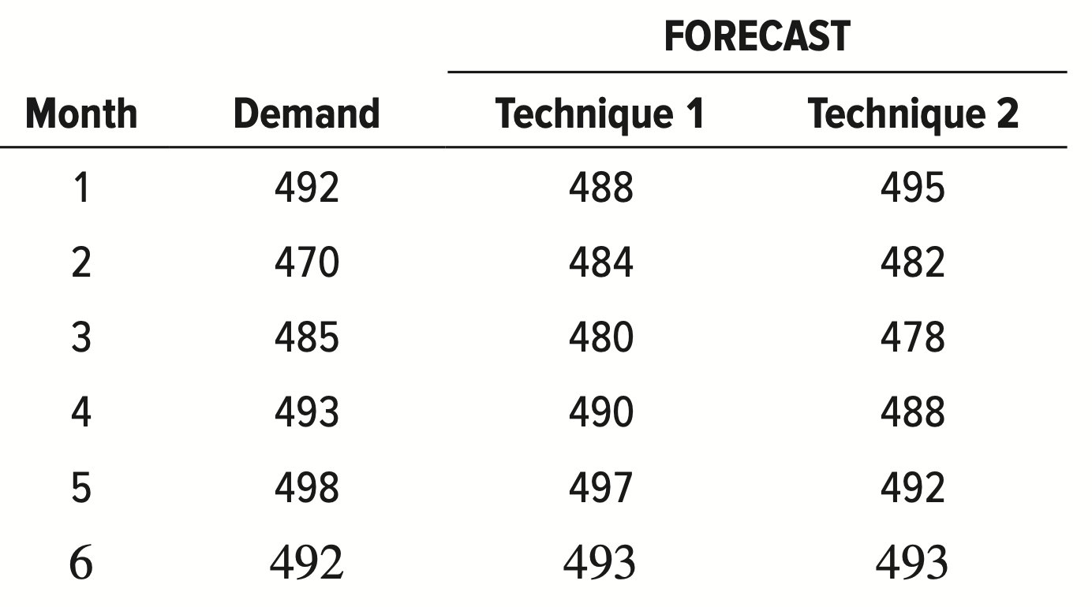
SUMMARIZING FORECAST ACCURACY

Slide 46
SUMMARIZING FORECAST ACCURACY
Solution: Technique 1
Period | Actual (A) | Forecast (F) | A-F | |A-F| | (|A-F|)² | (|A-F|/A) × 100
1 | 492 | 488 | 4 | 4 | 16 | 0.81
2 | 470 | 484 | -14 | 14 | 196 | 2.98
3 | 485 | 480 | 5 | 5 | 25 | 1.03
4 | 493 | 490 | 3 | 3 | 9 | 0.61
5 | 498 | 497 | 1 | 1 | 1 | 0.20
6 | 492 | 493 | -1 | 1 | 1 | 0.20
TOTAL |  |  |  | 28 | 248 | 5.83%
Mean Absolute Deviation (MAD) = 28/6 = 4.67
Mean Squared Error (MSE) = 248/ (6-1) = 248/5 = 49.6
Mean Absolute Percent Error (MAPE) = 5.83/6 = 0.97%

Slide 47
SUMMARIZING FORECAST ACCURACY
Solution: Technique 2
Period | Actual (A) | Forecast (F) | A-F | |A-F| | (|A-F|)² | (|A-F|/A) × 100
1 | 492 | 495 | -3 | 3 | 9 | 0.61
2 | 470 | 482 | -12 | 12 | 144 | 2.55
3 | 485 | 478 | 7 | 7 | 49 | 1.44
4 | 493 | 488 | 5 | 5 | 25 | 1.01
5 | 498 | 492 | 6 | 6 | 36 | 1.20
6 | 492 | 493 | -1 | 1 | 1 | 0.20
TOTAL |  |  |  | 34 | 264 | 7.01%
Mean Absolute Deviation (MAD) = 34/6 = 6.67
Mean Squared Error (MSE) = 264/ (6-1) = 264/5 = 52.8
Mean Absolute Percent Error (MAPE) = 7.01/6 = 1.17%

Slide 48
SUMMARIZING FORECAST ACCURACY
Solution: Technique 1
Mean Absolute Deviation (MAD) = 28/6 = 4.67
Mean Squared Error (MSE) = 248/ (6-1) = 248/5 = 49.6
Mean Absolute Percent Error (MAPE) = 5.83/6 = 0.97%
Solution: Technique 2
Mean Absolute Deviation (MAD) = 34/6 = 6.67
Mean Squared Error (MSE) = 264/ (6-1) = 264/5 = 52.8
Mean Absolute Percent Error (MAPE) = 7.01/6 = 1.17%
As we got, MAD _{Technique 1} < MAD _{Technique 2}, which indicates that Technique # 1 will be more accurate than Technique # 2.
Similarly we can compare, MSE _{Technique 1} and MSE _{Technique 2}, and MAPE _{Technique 1} and MAPE _{Technique 2}, which eventually indicates that, the lesser deviated value will indicate more Accuracy.

Slide 49
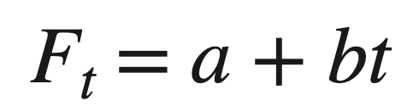
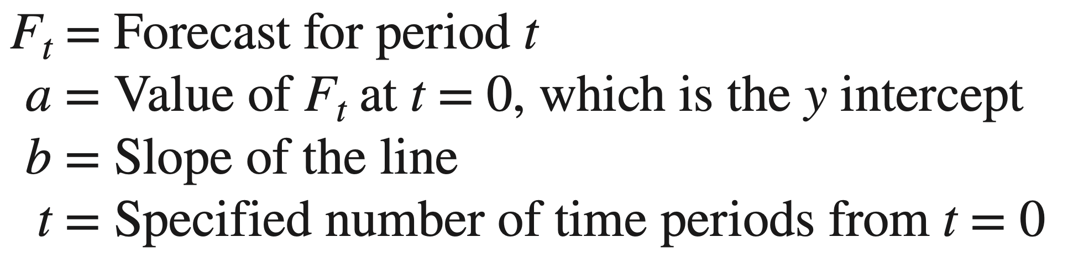
TECHNIQUES FOR TREND
Analysis of trend involves developing an equation that will suitably describe trend (assuming that trend is present in the data).
Trend Equation A linear trend equation has the form
Regression analysis

Slide 50
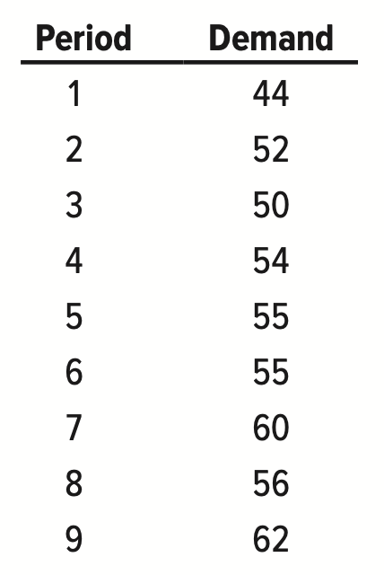
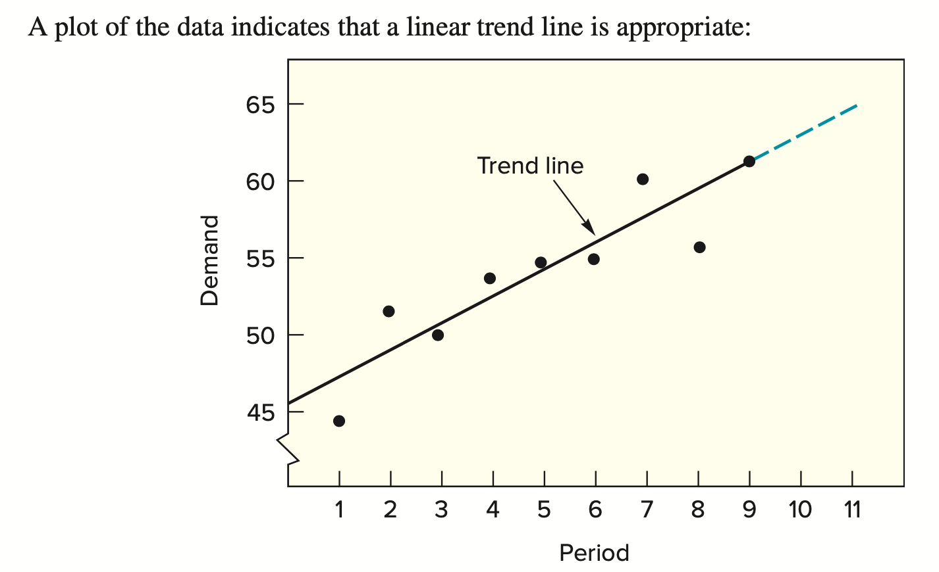
TECHNIQUES FOR TREND
62.97
64.72

Slide 51
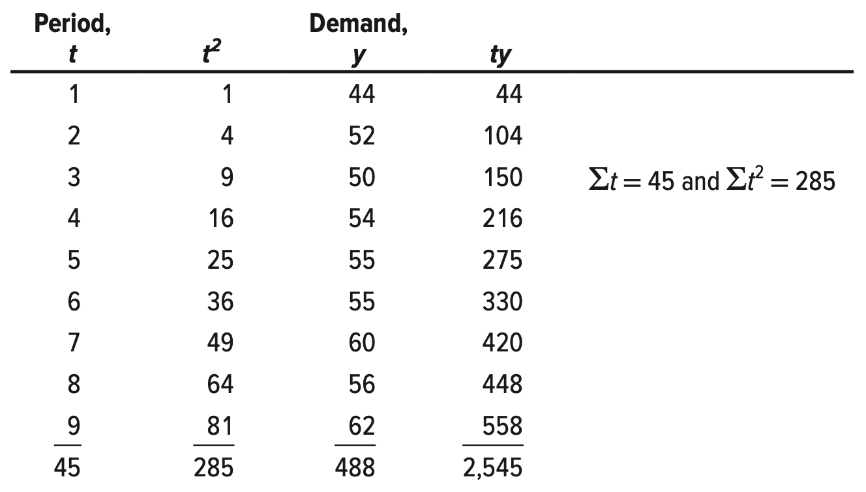
TECHNIQUES FOR TREND

Slide 52
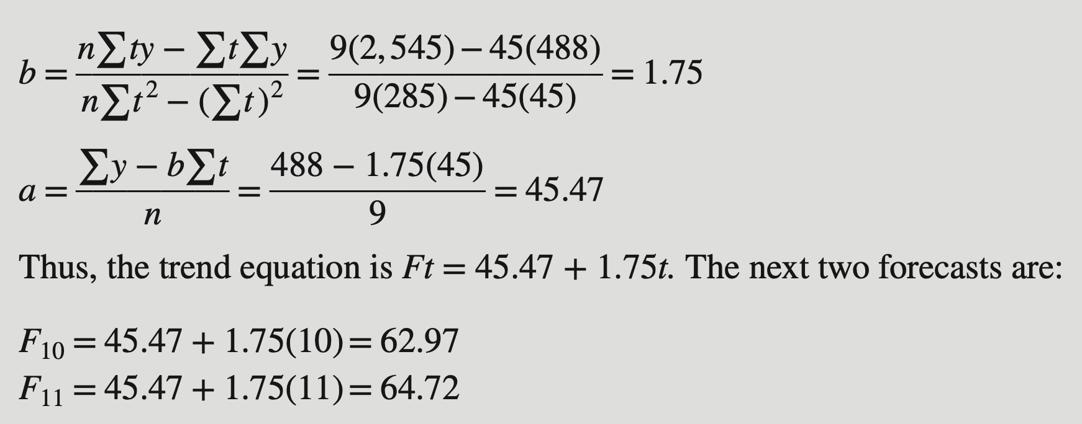
TECHNIQUES FOR TREND
Regression analysis

Slide 53
Practice # 1
Week | Passengers Travelled
1 | 1000
2 | 1200
3 | 1500
4 | 2000
5 | 1700
6 | 1800
Week (t) | t² | Passengers (y) | ty
1 | 1 | 1000 | 1000
2 | 4 | 1200 | 2400
3 | 9 | 1500 | 4500
4 | 16 | 2000 | 8000
5 | 25 | 1700 | 8500
6 | 36 | 1800 | 10800
21 | 91 | 9200 | 35200

Slide 54
Practice # 1
Week (t) | t² | Passengers (y) | ty
1 | 1 | 1000 | 1000
2 | 4 | 1200 | 2400
3 | 9 | 1500 | 4500
4 | 16 | 2000 | 8000
5 | 25 | 1700 | 8500
6 | 36 | 1800 | 10800
21 | 91 | 9200 | 35200
b = 6(35200)- 21(9200)/ 6(91) – (21)² a = 9200 – 171.43 (21)/ 6
= 211200 – 193200 / 546 – 441 = 9200 – 3600.03 / 6
= 18000/ 105 = 5599.97/ 6
= 171.43 = 933.33
Thus, the trend equation is F_{t} = a + b t = 933.33 + 171.43t
F₇ = 933.33+ 171.43(7) = 933.33 + 1200.01 = 2133.34
F₈ = 933.33+ 171.43(8) = 933.33 + 1371.44 = 2304.77

Slide 55
Practice # 2
Cell phone sales for a New firm is based over the last ten weeks as shown.
Determine the linear equation and predict the sales for the weeks of 11 and 12..40+7.51t
Week | 1 | 2 | 3 | 4 | 5 | 6 | 7 | 8 | 9 | 10
Sales | 700 | 724 | 720 | 728 | 740 | 742 | 758 | 750 | 770 | 775

Slide 56
Practice # 2
Week (t) | t² | Sales (y) | ty
1 | 1 | 700 | 700
2 | 4 | 724 | 1448
3 | 9 | 720 | 2160
4 | 16 | 728 | 2912
5 | 25 | 740 | 3700
6 | 36 | 742 | 4452
7 | 49 | 758 | 5306
8 | 64 | 750 | 6000
9 | 81 | 770 | 6930
10 | 100 | 775 | 7750
55 | 385 | 7407 | 41358

Slide 57
Practice # 2
Week (t) | t² | Sales (y) | ty
1 | 1 | 700 | 700
2 | 4 | 724 | 1448
3 | 9 | 720 | 2160
4 | 16 | 728 | 2912
5 | 25 | 740 | 3700
6 | 36 | 742 | 4452
7 | 49 | 758 | 5306
8 | 64 | 750 | 6000
9 | 81 | 770 | 6930
10 | 100 | 775 | 7750
55 | 385 | 7407 | 41358
b = 10(41358) - 55(7407)/ 10(385) – (55)²
= 413580 – 407385 / 3850 – 3025
= 6195/825
= 7.51
a = 7407 – 7.51(55)/10
= 7407 – 413.05/10
= 6993.95/10
= 699.40
Thus, the trend equation is F_{t} = a + b t = 699.40 + 7.51t
F₁₁ = 699.40 + 7.51(11) = 699.40 + 82.61 = 782
F₁₂ = 699.40 + 7.51(12) = 699.40 + 90.12 = 790

Slide 58
Exercise-3
e. Calculate the accuracy of forecasting by measuring the parameters MAD, MSE and MAPE of the solution generated from question (d)

Slide 59
Exercise-3- Solution
a.
b.

Slide 60
Exercise-3- Solution

Slide 61
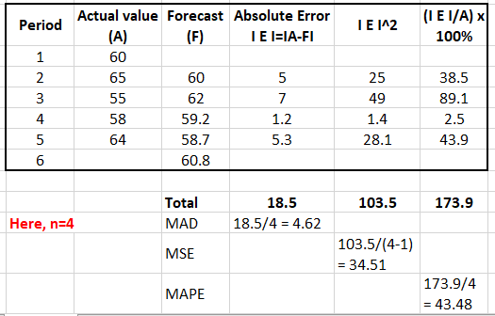
Exercise-3- Solution

Slide 62
END OF THE CHAPTER

